Slide 1

PARKING SPACE DETECT
_Amanullah Tariq, Muazzam Ali and Deep Ganatra

Slide 2
Content
TASK 1 : Parking area detection in 2D Image
KEY IDEA : Detect patterns in Parking area.
Results
TASK 2 : 2D – 3D Registration
KEY IDEA : Register known correspondence points
Ground plane detection and filtering
TASK 3 : Segmentation of objects and 2D-3D Mapping
Step 1 : Object Detection
Step 2 : Applying Supervised Learning
Step 3 : Combining 2D – 3D data

Slide 3
TASK 1: Parking area detection in 2D Image
Detect parking area features in images (e.g., lines, corners, patterns…)
Generate a map of parking spaces.

Slide 4
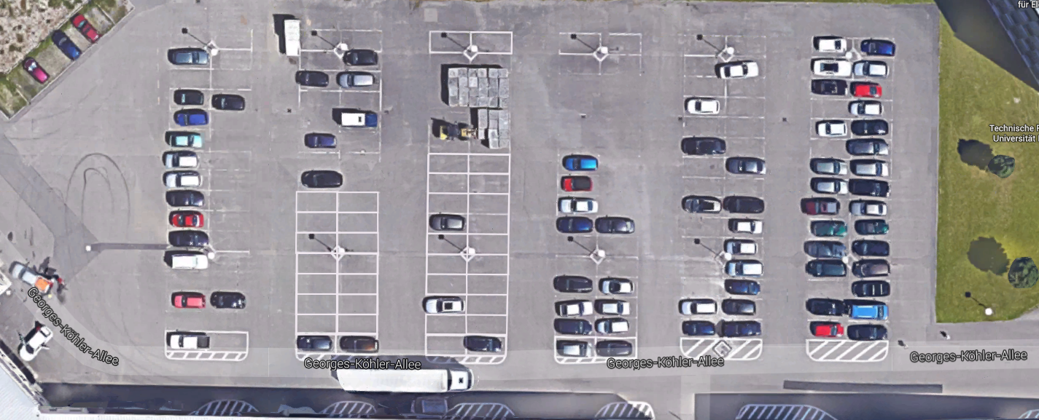
Applying Bilateral
Original Image
Notes:
http://docs.opencv.org/doc/tutorials/imgproc/gausian_median_blur_bilateral_filter/gausian_median_blur_bilateral_filter.html
http://homepages.inf.ed.ac.uk/rbf/CVonline/LOCAL_COPIES/MANDUCHI1/Bilateral_Filtering.html

Slide 5
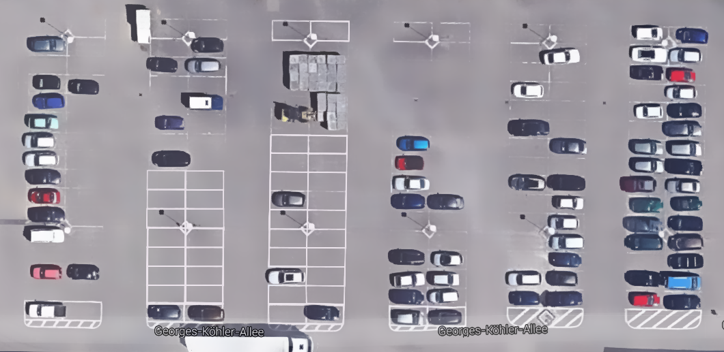
Applying Bilateral
Bilateral Image

Slide 6
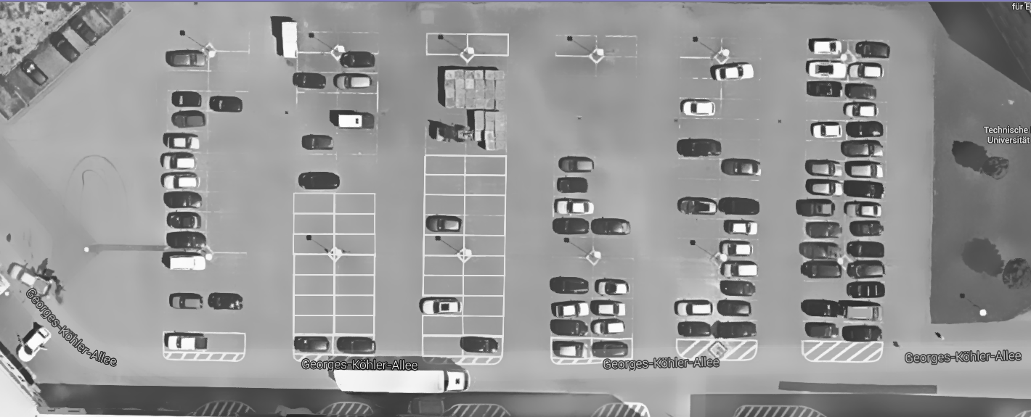
Converting Image to Grey for easy processing

Slide 7
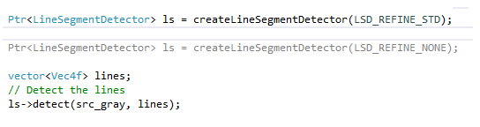
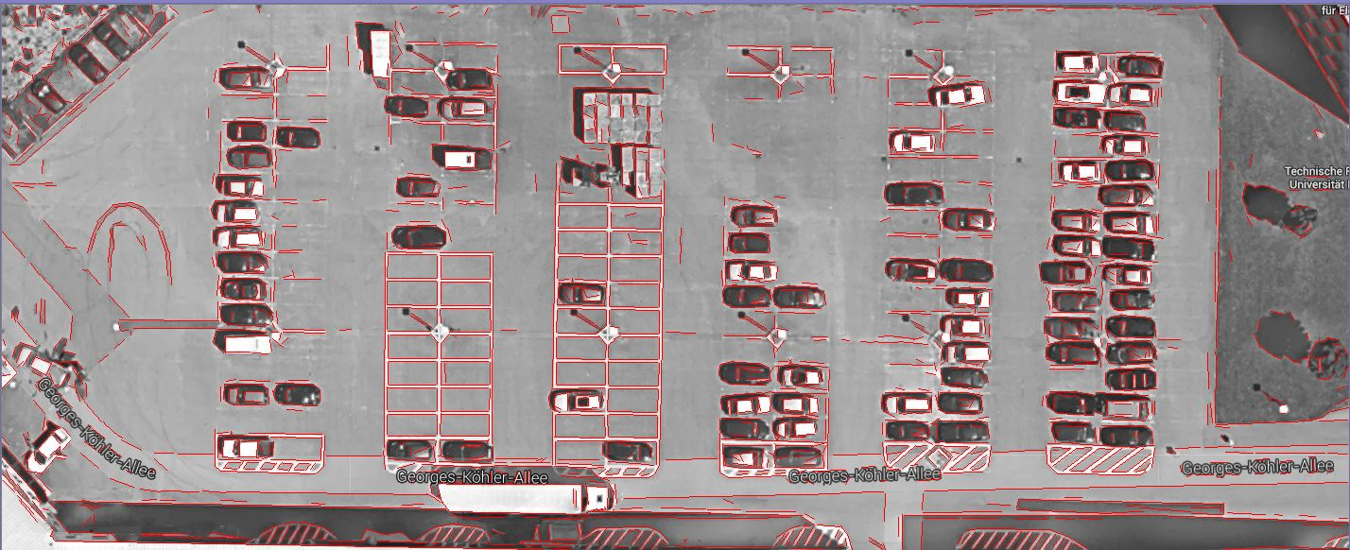
Detecting Line Segments
Algorithm : Line Segment Detect (OpenCV 3.0).
Notes:
http://docs.opencv.org/3.0-beta/modules/line_descriptor/doc/LSDDetector.html

Slide 8
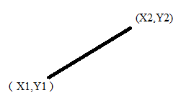
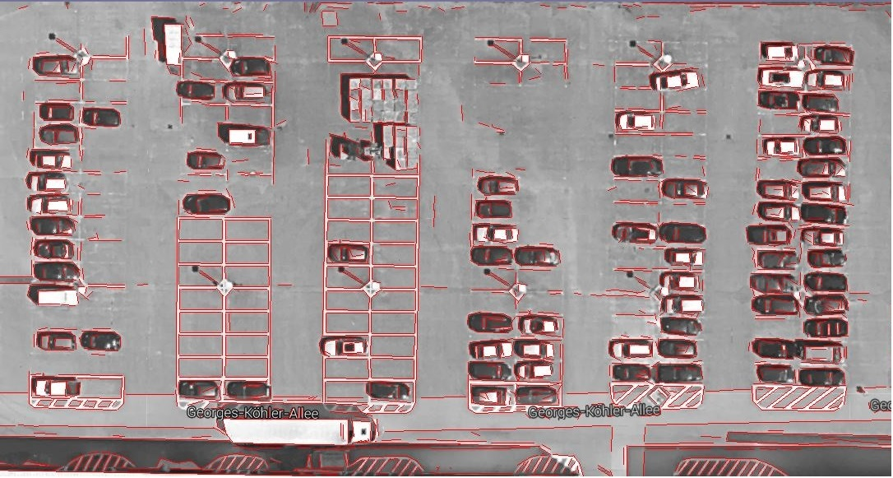
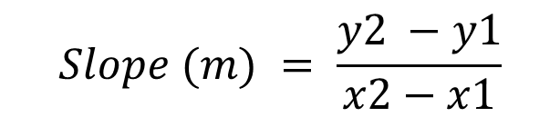
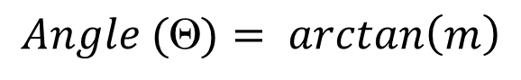
Categorising Lines on basis of Slopes
$$Slope (m) = \frac{y2 −y1}{x2−x1}$$
$$Angle (Θ)= arctan\left(m\right)$$

Slide 9
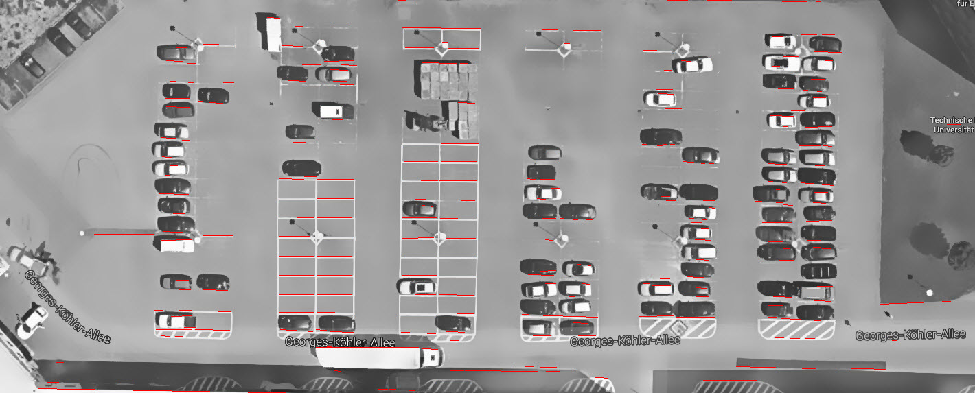
Working with Lines at same slope

Slide 10
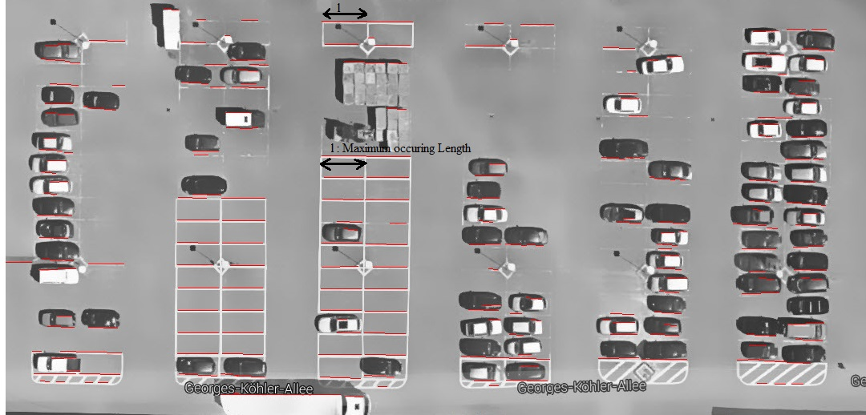
Categorize lines at same slope, by length and threshold
Maxlinelength = length of most occurring lines (l)

Slide 11
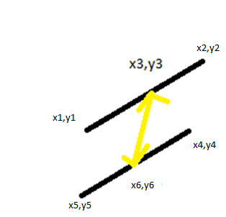
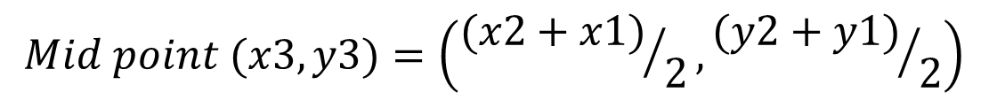
Calculating distance between mid-points of the lines
$$Mid point (x3,y3)=\left({(x2+x1)}/2,{(y2+y1)}/2\right)$$
$$Euclidien distance, d= \sqrt{{(x6−x3)}^{2}+{(y6−y3)}^{2}}$$

Slide 12
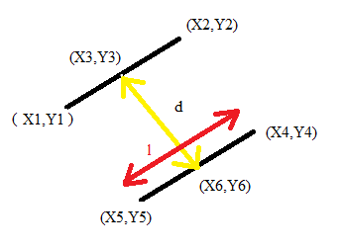
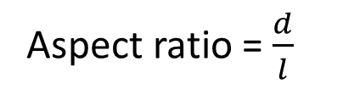
Checking Aspect ratio
Aspect ratio = $\frac{d}{l}$
0.4 < Aspect ratio for rectangle < 0.7

Slide 13
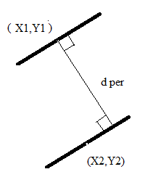
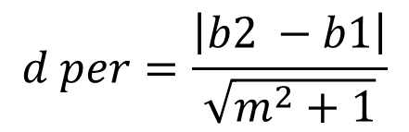
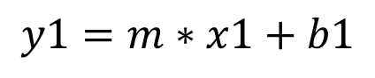
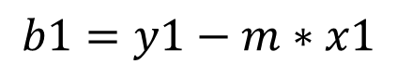
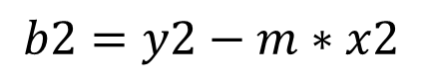
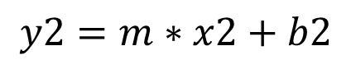
Calculating perpendicular distance between lines
$$y1=m∗x1+b1$$
$$y2=m∗x2+b2$$
$$b1=y1−m∗x1$$
$$b2=y2−m∗x2$$
$$d per=\frac{\left|b2 −b1\right|}{\sqrt{m^{2}+1}}$$
Notes:
https://en.wikipedia.org/wiki/Distance_between_two_straight_lines

Slide 14
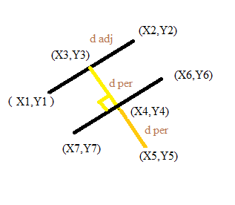
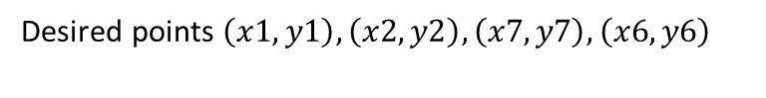
Getting rectangle corner points
$$\left(x4,y4\right)=\left(x3,y3\right)+\frac{d per}{\sqrt{{(y1−y2)}^{2}+{(x2−x1)}^{2}}} ∗((y1−y2),(x2−x1))$$
Desired points $\left(x1,y1\right),\left(x2,y2\right),\left(x7,y7\right),\left(x6,y6\right)$
Notes:
Unit vector in direction of desired point, multiply by the distance is the new point.

Slide 15
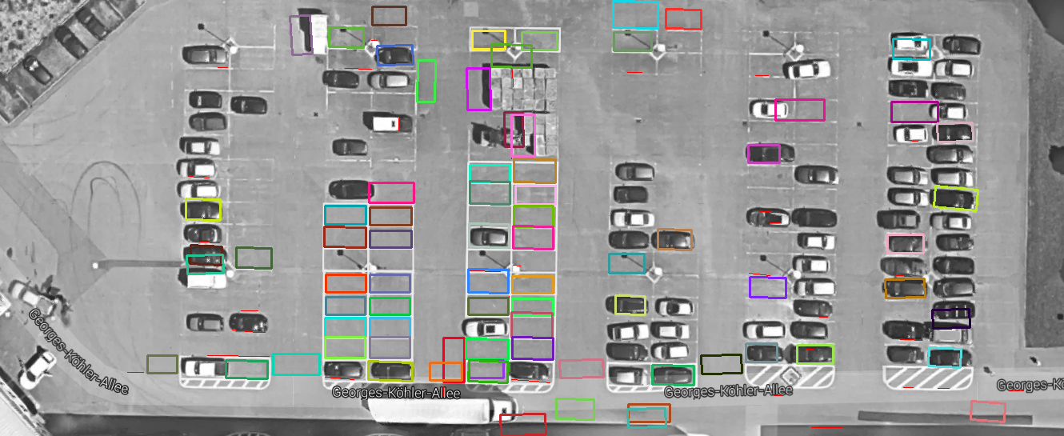
Rectangle plotted results

Slide 16
TASK 2: 2D – 3D Registration

Slide 17
TASK 2: 2D – 3D Registration
Manually detect the Correspondence points.
Compute a transformation of the 2D image and the 3D point cloud.

Slide 18
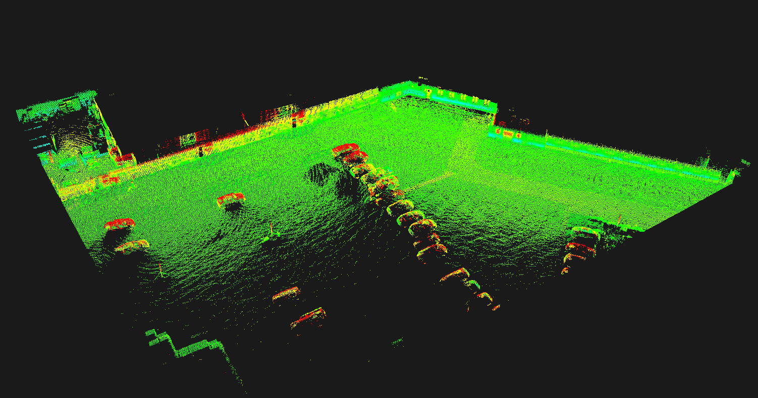
3D PCD with Intensity of parking space

Slide 19
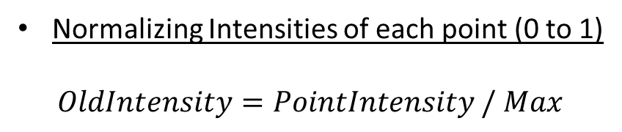
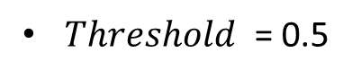
Normalizing & Thresholding the Intensity values
$Max$ = Maximum Intensity value in Point Cloud Data
Normalizing Intensities of each point (0 to 1)
$$OldIntensity=PointIntensity / Max$$
$Threshold$ = 0.5

Slide 20
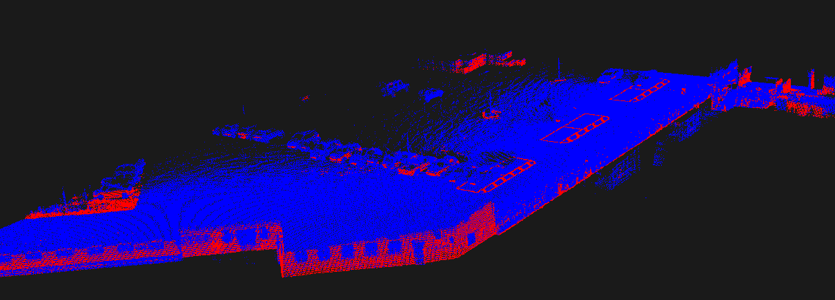
New Intensity value
$NewPointIntensity=Max ∗(OldIntensity<Threshold)$
$NewPointIntensity=0 ∗(OldIntensity> Threshold)$

Slide 21
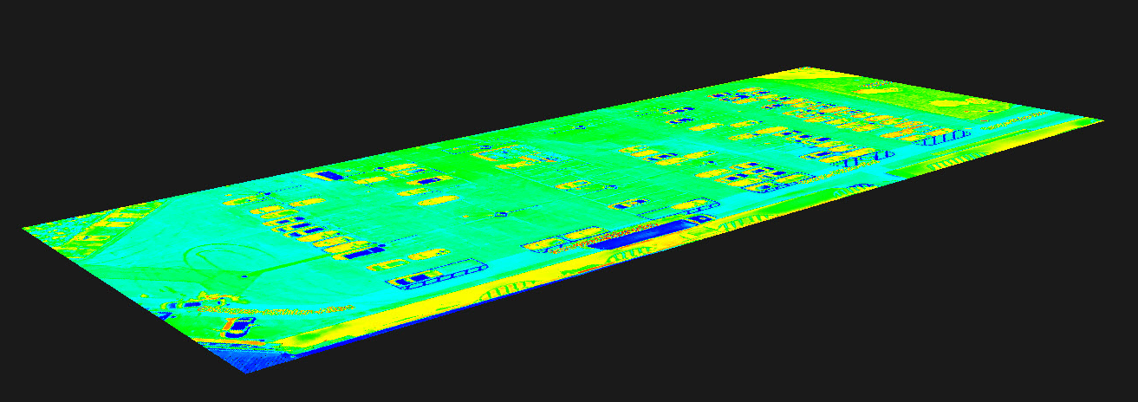
2D image and Point Cloud

Slide 22
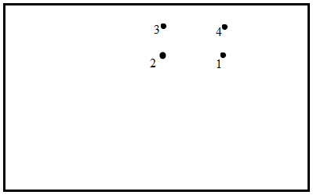
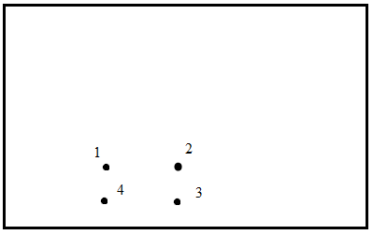
KEY IDEA : Register known correspondance points

Slide 23
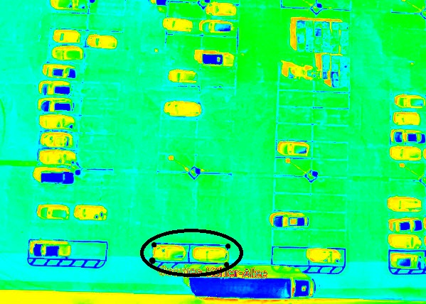
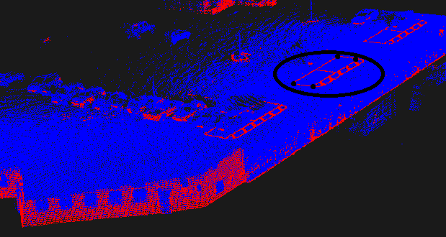
Correspondence points

Slide 24
Transformation using Umeyama¹ Algorithm
Least square estimation of the transformation parameters.
Single Value Decomposition of covariance matrix.
Notes:
http://web.stanford.edu/class/cs273/refs/umeyama.pdf

Slide 25
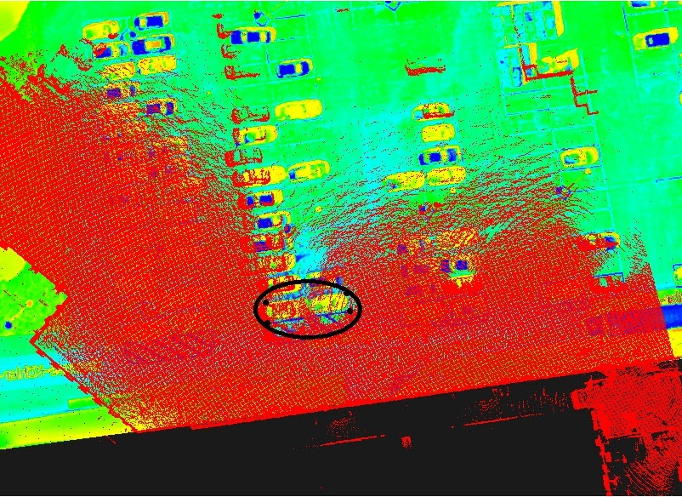
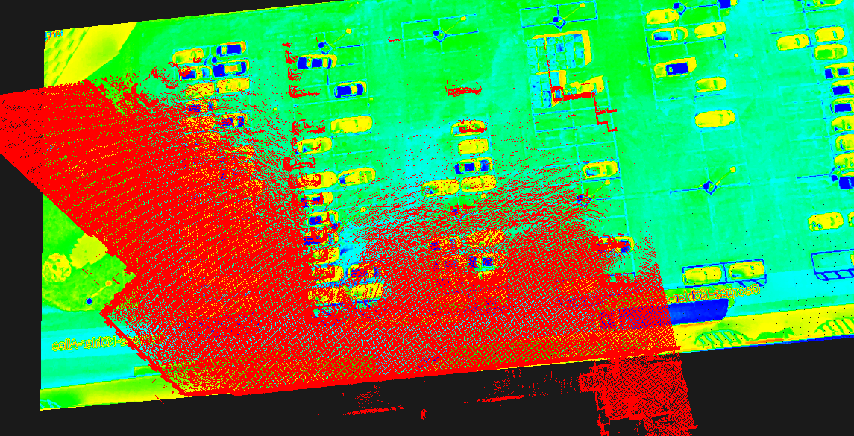

Slide 26
Ground plane detection and filtering
Notes:
Reference:
http://pointclouds.org/documentation/tutorials/planar_segmentation.php
SACMODEL_PLANE - used to determine plane models. The four coefficients of the plane are its Hessian Normal form: [normal_x normal_y normal_z d]
seg.setModelType (pcl::SACMODEL_PLANE);
seg.setMethodType (pcl::SAC_RANSAC);
seg.setDistanceThreshold (3);

Slide 27
RANSAC – Random Sample Consensus
Algorithm for robust model fitting
Select sample Set – Point Cloud Data
Computes Model - SACMODEL_PLANE
Computes inliers – Points in Plane
Repeats until sufficient confident.

Slide 28
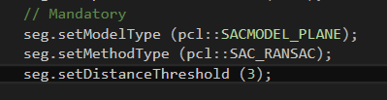
SACMODEL_PLANE ¹
The four coefficients of the plane are its Hessian Normal form: [normal_x, normal_y, normal_z, d]
Notes:
Reference:
http://pointclouds.org/documentation/tutorials/planar_segmentation.php
SACMODEL_PLANE - used to determine plane models. The four coefficients of the plane are its Hessian Normal form: [normal_x normal_y normal_z d]
seg.setModelType (pcl::SACMODEL_PLANE);
seg.setMethodType (pcl::SAC_RANSAC);
seg.setDistanceThreshold (3);

Slide 29
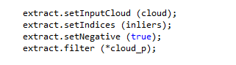
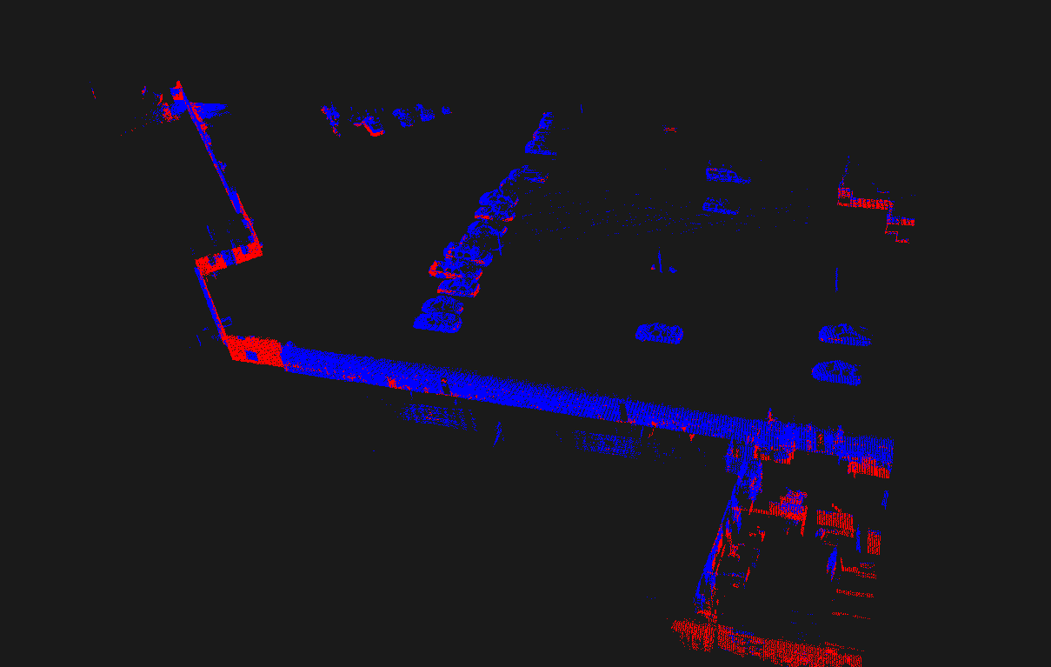
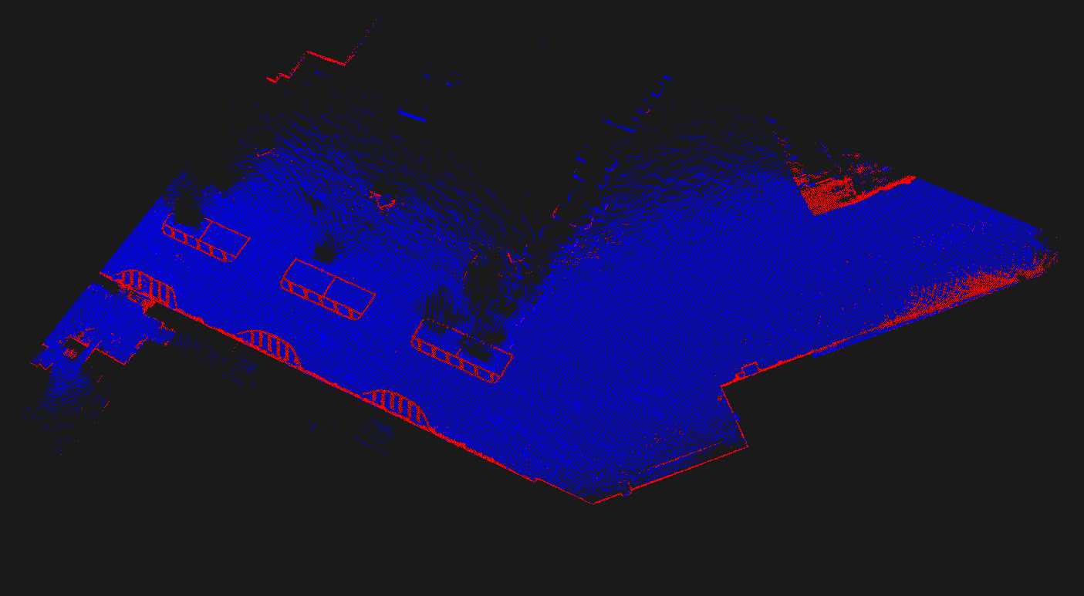
Filtering out the plane using EXTRACT INDICES
Point cloud with Extract indices
Plane detected

Slide 30
Task 3: Car Detection

Slide 31
Task 3: Car Detection (Required)
Registration from previous task provides a segmentation of cars.
Use these point clouds as training examples to compute car features.
Implement a car detector.
Map Improvement.

Slide 32
Task 3: Car Detection (Solution)
Object Detection
Clustering Methods
Identifying Threshold Values
Applying Supervised Learning
Logistic Regression
Combining 2D and 3D data
Matching
Drawing
Reference:
Logistics Regression
Notes:
The binary logistic model is used to predict a binary response based on one or more predictor variables (features), making it a probabilistic classification model in the parlance of machine learning,^{[4]} or a qualitative response/discrete choice model in the terminology of economics.

Slide 33
Step 1: Object Detection

Slide 34
Step 1: Object Detection
Clustering Methods
Euclidean Cluster Extraction
Region Growing Segmentation
Identifying Threshold
Manual feature(s) detection

Slide 35
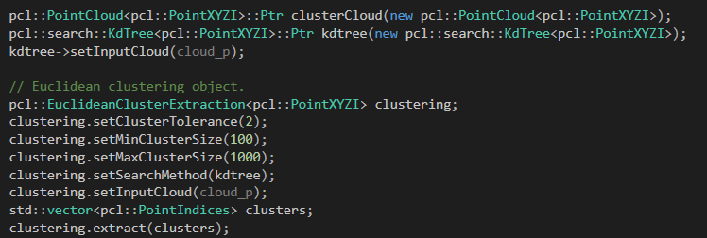
Euclidean Cluster Extraction
Euclidean Cluster Extraction
Reference:
Euclidean Cluster Extraction
KD-Tree
Notes:
http://www.pointclouds.org/documentation/tutorials/cluster_extraction.php

Slide 36
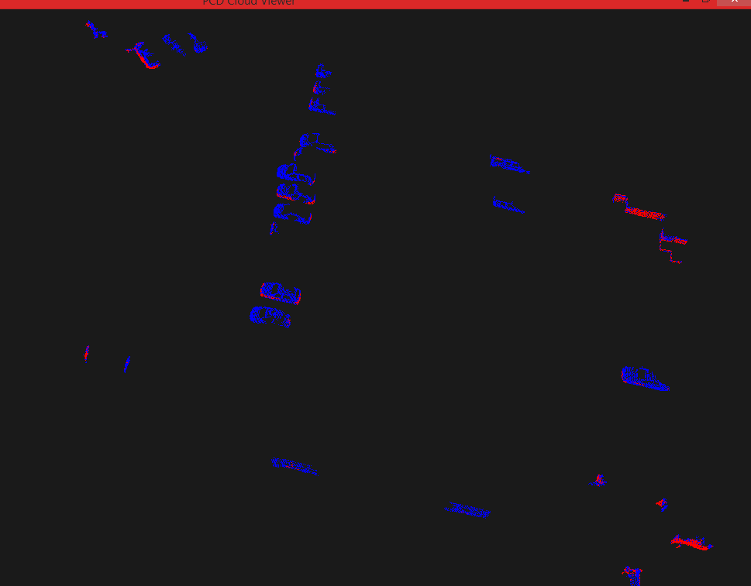
Euclidean Custer Extraction
Euclidean Cluster Extraction (Continue)
Blue objects are identified clusters
Reference:
Euclidean Cluster Extraction
KD-Tree
Notes:
http://www.pointclouds.org/documentation/tutorials/cluster_extraction.php

Slide 37
Region Growing Segmentation
This algorithm merge the points that are close enough in terms of the smoothness constraint. Thereby, the output of this algorithm is the set of clusters, were each cluster is a set of points that are considered to be a part of the same smooth surface. The work of this algorithm is based on the comparison of the angles between the points normal.
Takes more time than Euclidean Cluster Extraction.
Reference:
Region Growing Segmentation

Slide 38
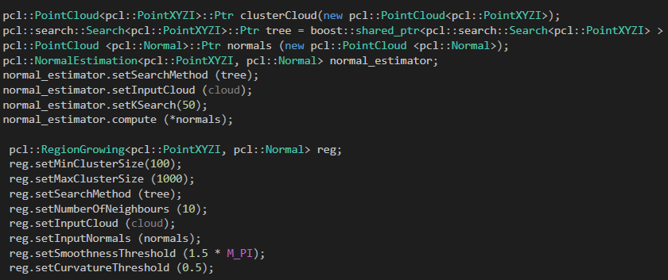
Region Growing Segmentation (Continue)

Slide 39
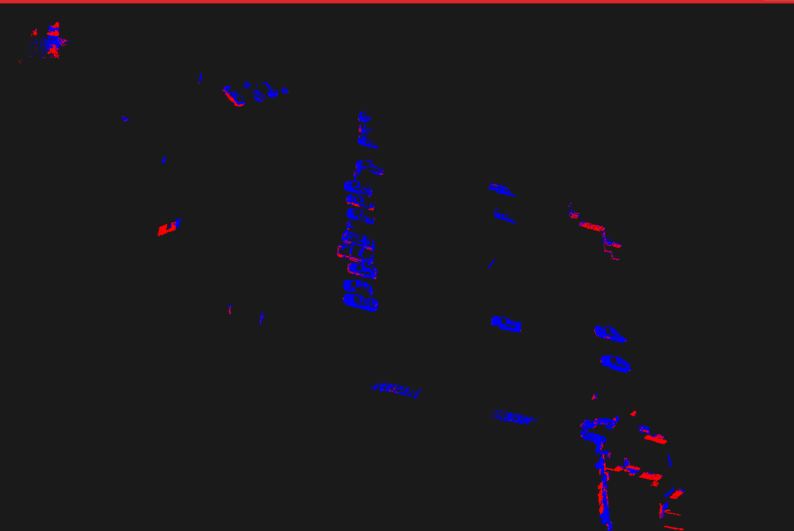
Region Growing Segmentation (Continue)
Blue objects are identified clusters
Reference:
Region Growing Segmentation

Slide 40
Comparison: Euclidean VS Region Growing
Euclidean
Region Growing
For our rest of the program we used Region Growing.

Slide 41
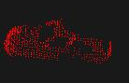
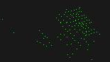
Identifying Threshold Values (Manually)
Manually visualize all the clusters and saved them in a Excel sheet.
Attributes saved where
Length ( y – value)
Height ( z – value)
Width ( x – value)
Type ( Car / Not Car)
Result

Slide 42
Problem(s)
Can we used the manually identified thresholds?
Hard coded values can lead to big errors.
What if truck comes and what if small car comes.
If we have to hard code the threshold values then why we are writing so much code?
How to solve this problem?
Supervised Learning.
Which supervised algorithm to use ?
Small feature list.
Only need to classify objects as Cars and Not Cars (binary)
SVM, Linear , logistic regression etc.
Reference:
Liblinear
Notes:
There are some large data for which with/without nonlinear mappings gives similar performances. Without using kernels, one can quickly train a much larger set via a linear classifier.
L2 uses Gaussians coefficients.
L1 uses Laplace coefficients.
L1 regularization does not give higher accuracy but may be slightly slower in training.

Slide 43
Step 2: Applying Supervised Learning

Slide 44
Step 2: Applying Supervised Learning
Process
Training
Prediction
Results
Output
Accuracy

Slide 45
Process (Training & Prediction)
Feature List as text file Model File/ learned function
.
Training
Clusters
Output (Classifying Clusters)
.
Predictor
Map
Model File

Slide 46
Process (continue)
Training
We use following solver or methods
L1-regularized logistic regression
L2-regularized L2-loss support vector classification (dual)
Prediction
Model
Output
Input
Reference:
Liblinear

Slide 47
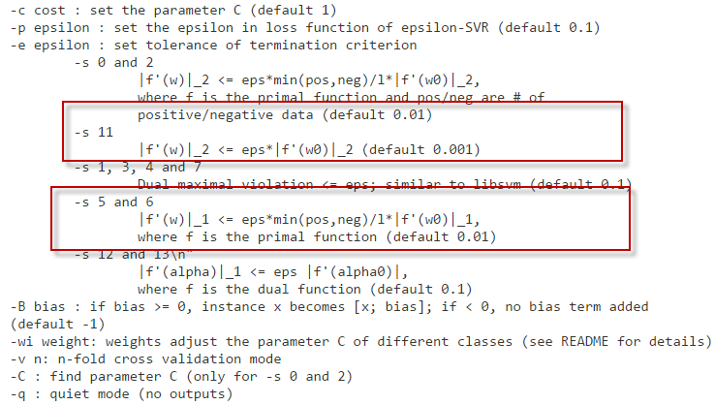
Process(Continue)
Reference:
Liblinear

Slide 48
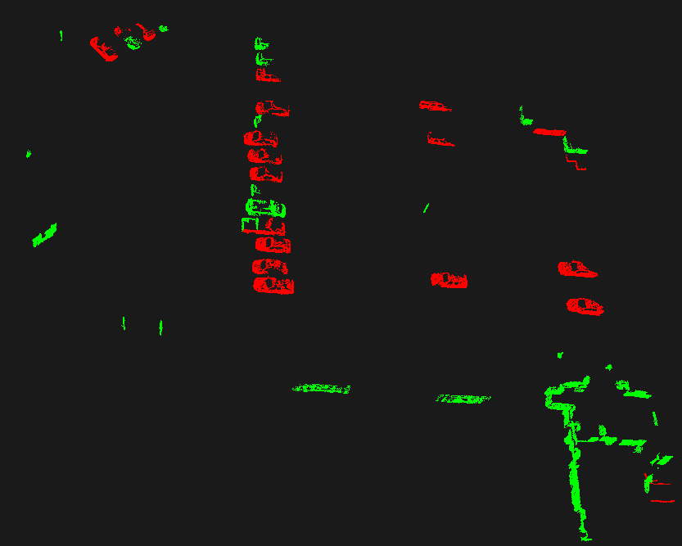
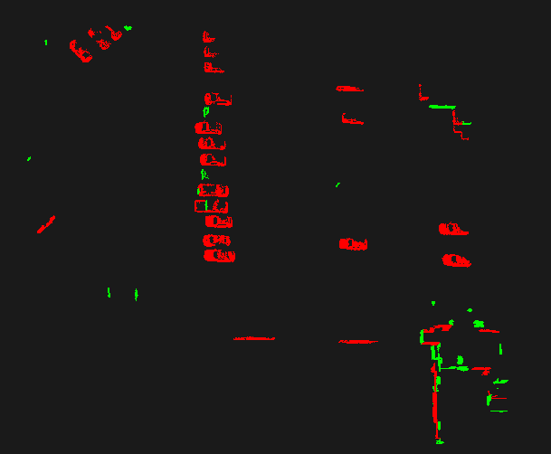
Results
Notes:
SVM is implemented in the LibLinear library that we use

Slide 49
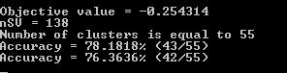
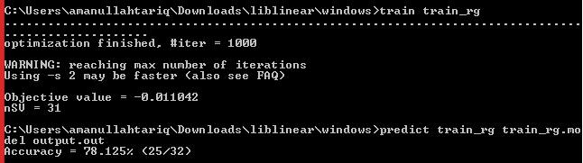
Accuracy
L1-regularized logistic regression
L2-regularized L2-loss support vector classification (dual)
Notes:
http://pointclouds.org/documentation/tutorials/region_growing_segmentation.php#region-growing-segmentation

Slide 50
Step 3: Combining 2D and 3D

Slide 51
What we will do next ?
Parking spots identified from 2D Image
Occupied Parking slots identified from PCD file
Final Map
(Parking and Vacant Spaces)

Slide 52
Step 3: Combining 2D and 3D
Matching
Possibilities of 2D and 3D data.
Drawing
Identifying Occupied Parking slots with the help of 3D data.
Drawing final map.

Slide 53
Matching
Possibilities of the data:

Slide 54

Matching (continue)

Slide 55

Drawing

Slide 56
Map Improvement

Slide 57


Map Improvement
How can we improved the generated map ?
How can we plot the remaining data or Cars, predicted by our Linear classifier?
Identify minimum and maximum point of each clusters and draw the rectangles:
Good Choice?

Slide 58
Map Improvement (Continue)

Slide 59
Danke Schön

